Slide 1





NFTs
PRICING
USING APIs
Anvitha Chaluvadi, Jacqueline Raynolds, and Maria Notarianni

Slide 2

WHY DO PEOPLE BUY NFTS
Collecting and Ownership
Investment
Supporting Artists and Creators
Virtual Identity and Status
Access to Exclusive Content or Experiences
Speculation and Hype
BACK TO TABLE OF CONTENTS
Notes:
Collecting and Ownership:
Just like collecting physical art or collectibles, some people buy NFTs to own a unique digital asset. NFTs represent ownership of a digital item, whether it's digital art, music, virtual real estate, or other digital creations. Owning an NFT can give collectors a sense of ownership and exclusivity.
Investment:
Some people buy NFTs as an investment opportunity. They believe that the value of certain NFTs will increase over time, similar to traditional art or collectibles. Just like investing in stocks, real estate, or cryptocurrencies, buying NFTs can be seen as a way to potentially profit from price appreciation in the future.
Supporting Artists and Creators:
Buying NFTs can be a way to support artists and creators directly. NFTs allow artists to monetize their digital creations in new ways, bypassing traditional intermediaries like galleries or record labels. By purchasing an artist's NFT, collectors can directly support the artist financially and help them continue to create.
Virtual Identity and Status:
In some cases, owning certain NFTs can confer social status or serve as a symbol of identity within virtual communities. For example, owning rare or prestigious NFTs within a specific online community or metaverse can signal status or membership.
Access to Exclusive Content or Experiences:
Some NFTs come with access to exclusive content or experiences. For example, purchasing an NFT might grant access to virtual events, VIP experiences, or special perks within a particular platform or ecosystem.
Speculation and Hype:
Like any emerging market, speculation and hype can also drive demand for NFTs. Some buyers may be attracted to NFTs simply because they see others profiting from them or because they perceive them as trendy or fashionable.

Slide 3

MOTIVATION & SUMMARY
Objective: To assist new NFT buyers in understanding NFT pricing.
Method: Utilizing a linear regression model, evaluating the predictive power of the Pudgy Penguin traits (features) .
Data Source: API data from the Pudgy Penguins collection on OpenSea.
Flexibility: The project could be adapted for other NFT collections.
PM Comment: Reduce features to improve model predictive power! The scope of the data was too broad.
BACK TO TABLE OF CONTENTS
Notes:
We would like to assist NFT buyers who are new to the market and do not understand NFT pricing very well. Buyers will evaluate individual NFTs, using a supervised learning model that has been deployed on Streamlit. We will also include ETH-USD exchange rates as features in the model and components of our analysis.
The project will utilize API data from one NFT the Pudgy Penguins collection on OpenSea; but, in principle, it could be modified and used for other collections by developers.

Slide 4



PUDGY PENGUINS
Collection: Pudgy Penguins
Number: 8,888 distinct NFTs
Purpose: Driving Web3 innovation
Values: Representing love, empathy, and positivity
Benefits: Exclusive access to events and experiences for owners
BACK TO TABLE OF CONTENTS
Notes:
Pudgy Penguins is a collection of 8,888 distinct NFTs, driving Web3 innovation through intellectual property and community support. These penguins represent love, empathy, and positivity, offering exclusive benefits to owners, including access to events and experiences.

Slide 5

1
Pudgy Penguins Collection
Volume: 345970.149573
Sales: 78963
Average Price: 4.381421
Number of Owners: 4778
Market Cap: 103268.203657
Floor Price: 12.5 ETH
Floor Price Symbol: ETH
BACK TO TABLE OF CONTENTS
Notes:
- to include
background info on collection:
volume sales average_price num_owners market_cap floor_price floor_price_symbol
0 345970.149573 78963 4.381421 4778 103268.203657 12.5 ETH
top 10 traits (and counts)
Skin.Normal 2649
Background.Blue 1587
Background.Mint 1389
Skin.Dark Gray 1329
Background.Purple 1282
Skin.Light Gray 1189
Background.Beige 1152
Background.Tangerine 1135
Face.Winking 961
Face.Blushing 932
top 5 backgrounds traits
Blue 1587.0
Mint 1389.0
Purple 1282.0
Beige 1152.0
Tangerine 1135.0
top 5 skin traits
Normal 2649.0
Dark Gray 1329.0
Light Gray 1189.0
Maroon 731.0
Olive Green 705.0
top 5 body traits
Shirt Blue 290.0
Kimono Brown 268.0
Shirt Red 259.0
Turtleneck Green 254.0
Scarf Green 250.0
top 5 face traits
Winking 961.0
Blushing 932.0
Normal 864.0
Circle Glasses 768.0
Cute 588.0
top 5 head traits
Headband 357.0
Flat Cap Blue 355.0
Bucket Hat Green 349.0
Backwards Hat Red 294.0
Hat Blue 286.0

Slide 6
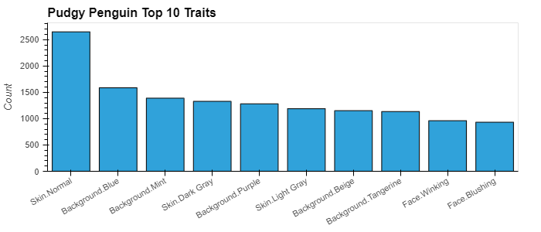
1
TOP TRAITS
Categories: 'Background', 'Skin', 'Body', 'Face', 'Head'
BACK TO TABLE OF CONTENTS
Notes:
- to include
background info on collection:
volume sales average_price num_owners market_cap floor_price floor_price_symbol
0 345970.149573 78963 4.381421 4778 103268.203657 12.5 ETH
top 10 traits (and counts)
Skin.Normal 2649
Background.Blue 1587
Background.Mint 1389
Skin.Dark Gray 1329
Background.Purple 1282
Skin.Light Gray 1189
Background.Beige 1152
Background.Tangerine 1135
Face.Winking 961
Face.Blushing 932
top 5 backgrounds traits
Blue 1587.0
Mint 1389.0
Purple 1282.0
Beige 1152.0
Tangerine 1135.0
top 5 skin traits
Normal 2649.0
Dark Gray 1329.0
Light Gray 1189.0
Maroon 731.0
Olive Green 705.0
top 5 body traits
Shirt Blue 290.0
Kimono Brown 268.0
Shirt Red 259.0
Turtleneck Green 254.0
Scarf Green 250.0
top 5 face traits
Winking 961.0
Blushing 932.0
Normal 864.0
Circle Glasses 768.0
Cute 588.0
top 5 head traits
Headband 357.0
Flat Cap Blue 355.0
Bucket Hat Green 349.0
Backwards Hat Red 294.0
Hat Blue 286.0

Slide 7


DATA CLEANUP
APIs Integration
Opensea APIs
Traits Summary Counts
NFT Sales Events
Individual NFT Information
Dataframe Components
Events Data
NFT Token (nft.identifier)
Closing Date (for ETH comparison)
Payment Quantity (wei)
Pagination (50 per page)
Individual NFT Info
Traits for Each NFT
Loop Function for Sampling 50 Sales
Exporting Data (static)
to_csv Command
BACK TO TABLE OF CONTENTS
Notes:
APIs fro
.gitignore the .env
Opensea APIs:
1. traits (summary counts) for stat analysis
2. events (sales of nfts)
3. individual nft info
Dataframe Components:
1. from events: nft token (nft.identifier), closing_date (for eth comparison), and payment.quantity (wei); pagination (50 per page)
2. from individual nft info: the traits for each nft - looped function for each of the 50 sales sample
Adding ETH-USD info
1. configuring datetime from unix
2. converting eth to usd
To_csv
We utilized OpenSea APIs to gather essential data for analysis. These APIs provided us with valuable insights through three main endpoints:
Firstly, the Traits endpoint gave us summary counts for traits, crucial for statistical analysis.
Secondly, the Events endpoint provided sales data, including NFT token details, closing dates for ETH comparison, and payment quantity in wei. We organized this data into manageable chunks, with 50 sales per page.
Lastly, the Individual NFT info endpoint enabled access to detailed NFT information, particularly focusing on traits. We efficiently gathered this data using a looped function for each of the 50 sampled sales.
To enhance our analysis further, we integrated ETH-USD exchange rates into our dataset. This involved configuring datetime values from Unix timestamps and converting ETH values to USD, providing a comprehensive view of pricing trends.
After compiling and processing our data, we exported it to a CSV file for deeper analysis and visualization. This systematic approach ensured we had the necessary insights to make informed decisions throughout our project.

Slide 8
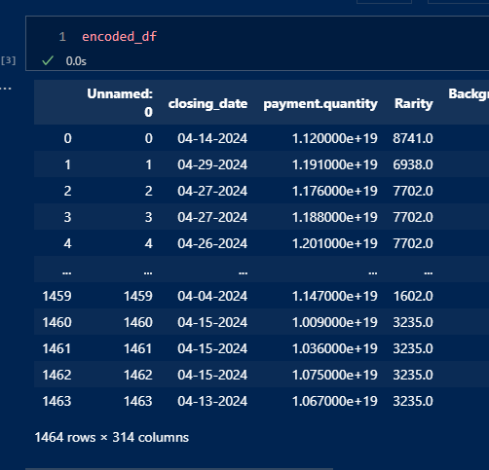

Encoded Data
BACK TO TABLE OF CONTENTS
Notes:
include model type
TT Split info + reasoning
results
datavisualization
what is the y-hat?
The purpose of this code is to calculate and display the evaluation metrics for a linear regression model. These metrics include the Mean Absolute Error (MAE), Mean Squared Error (MSE), Root Mean Squared Error (RMSE), and the R-squared (R²) Score. These metrics help in understanding the model's performance by measuring the difference between the actual and predicted values.
Mean Absolute Error (MAE): the measure of the average absolute errors between the true values and the predicted values. It tells you how close, on average, the predictions are to the true values. In this case, the MAE is approximately 22.34.
Mean Squared Error (MSE): The MSE is a measure of the average squared errors between the true values and the predicted values. It penalizes larger errors more heavily than smaller ones. In this case, the MSE is approximately 114213.79.
Root Mean Squared Error (RMSE): The RMSE is the square root of the MSE. It provides an interpretable measure of the average magnitude of error in the same units as the target variable. In this case, the RMSE is approximately 337.96.
R-squared (R²) Score: The R-squared score, also known as the coefficient of determination, measures the proportion of the variance in the dependent variable that is explained by the independent variables. It ranges from 0 to 1, with higher values indicating a better fit of the model to the data. In this case, the R² score is 1.0, which indicates a perfect fit of the model to the data.
Overall, these metrics provide insights into how well the linear regression model is performing in terms of prediction accuracy and model fit. A lower MAE, MSE, and RMSE, and a higher R² score indicate better performance of the model.

Slide 9
Linear Regression Model
EVALUATION
R^2 : “Whereas correlation explains the strength of the relationship between an independent and a dependent variable, R-squared explains the extent to which the variance of one variable explains the variance of the second variable. So, if the R2 of a model is 0.50, then approximately half of the observed variation can be explained by the model’s inputs.”
source: https://www.investopedia.com/terms/r/r-squared.asp
Training Dataset (Descriptive Value)
R-squared (R²) Score: 0.6909513484448644
This means that traits strongly describes price in training data! (Only 30% noise!)
Testing Dataset (Predictive Value)
R-squared (R²) Score: -1.4725014974827797e+26
This means the model cannot predict anything! But why…?
BACK TO TABLE OF CONTENTS
Notes:
include model type
TT Split info + reasoning
results
datavisualization
what is the y-hat?
The purpose of this code is to calculate and display the evaluation metrics for a linear regression model. These metrics include the Mean Absolute Error (MAE), Mean Squared Error (MSE), Root Mean Squared Error (RMSE), and the R-squared (R²) Score. These metrics help in understanding the model's performance by measuring the difference between the actual and predicted values.
Mean Absolute Error (MAE): the measure of the average absolute errors between the true values and the predicted values. It tells you how close, on average, the predictions are to the true values. In this case, the MAE is approximately 22.34.
Mean Squared Error (MSE): The MSE is a measure of the average squared errors between the true values and the predicted values. It penalizes larger errors more heavily than smaller ones. In this case, the MSE is approximately 114213.79.
Root Mean Squared Error (RMSE): The RMSE is the square root of the MSE. It provides an interpretable measure of the average magnitude of error in the same units as the target variable. In this case, the RMSE is approximately 337.96.
R-squared (R²) Score: The R-squared score, also known as the coefficient of determination, measures the proportion of the variance in the dependent variable that is explained by the independent variables. It ranges from 0 to 1, with higher values indicating a better fit of the model to the data. In this case, the R² score is 1.0, which indicates a perfect fit of the model to the data.
Overall, these metrics provide insights into how well the linear regression model is performing in terms of prediction accuracy and model fit. A lower MAE, MSE, and RMSE, and a higher R² score indicate better performance of the model.

Slide 10
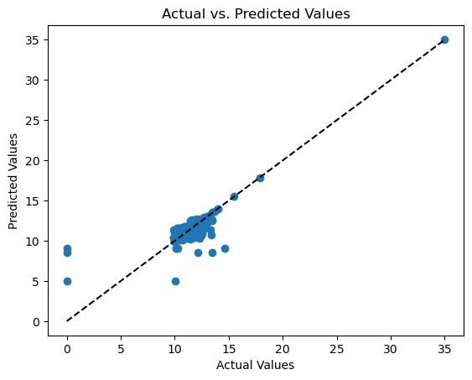
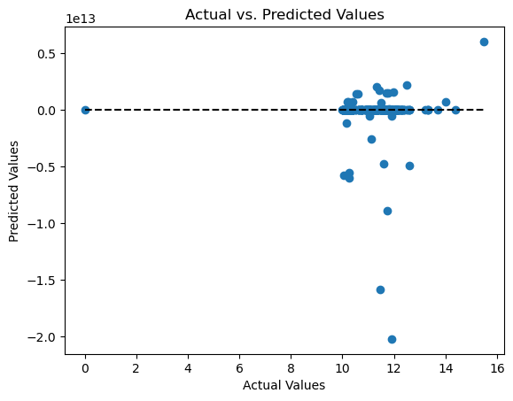


RESULTS
Model Evaluation Metrics
Training Dataset
Training Dataset
BACK TO TABLE OF CONTENTS
Notes:
The purpose of this code is to calculate and display the evaluation metrics for a linear regression model. These metrics include the Mean Absolute Error (MAE), Mean Squared Error (MSE), Root Mean Squared Error (RMSE), and the R-squared (R²) Score. These metrics help in understanding the model's performance by measuring the difference between the actual and predicted values.
Mean Absolute Error (MAE): the measure of the average absolute errors between the true values and the predicted values. It tells you how close, on average, the predictions are to the true values. In this case, the MAE is approximately 22.34.
Mean Squared Error (MSE): The MSE is a measure of the average squared errors between the true values and the predicted values. It penalizes larger errors more heavily than smaller ones. In this case, the MSE is approximately 114213.79.
Root Mean Squared Error (RMSE): The RMSE is the square root of the MSE. It provides an interpretable measure of the average magnitude of error in the same units as the target variable. In this case, the RMSE is approximately 337.96.
R-squared (R²) Score: The R-squared score, also known as the coefficient of determination, measures the proportion of the variance in the dependent variable that is explained by the independent variables. It ranges from 0 to 1, with higher values indicating a better fit of the model to the data. In this case, the R² score is 1.0, which indicates a perfect fit of the model to the data.
Overall, these metrics provide insights into how well the linear regression model is performing in terms of prediction accuracy and model fit. A lower MAE, MSE, and RMSE, and a higher R² score indicate better performance of the model.

Slide 11
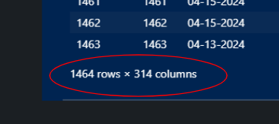

DISCUSSION and POSTMORTEM
Why is the model garbage? Because there are too many features (300+) and limited elements in the dataset (<1500). Ideally, there would be more elements and fewer features. (Sean says MUCH more.)
Future avenues for solving this problem!
converting ETH-USD
fixing API issues
Isolating traits (maybe top 10 traits?)
We attempted to address overfitting with PCA feature reduction, but the explained variance ratio was very low.
We would pull more data to address LR overfitting, but without the ETH-USD conversion, it would impact outcomes related to big conversion fluctuations in the past year.
BACK TO TABLE OF CONTENTS

Slide 12
Shout Outs!
BACK TO TABLE OF CONTENTS
Notes:
include model type
TT Split info + reasoning
results
datavisualization
what is the y-hat?
The purpose of this code is to calculate and display the evaluation metrics for a linear regression model. These metrics include the Mean Absolute Error (MAE), Mean Squared Error (MSE), Root Mean Squared Error (RMSE), and the R-squared (R²) Score. These metrics help in understanding the model's performance by measuring the difference between the actual and predicted values.
Mean Absolute Error (MAE): the measure of the average absolute errors between the true values and the predicted values. It tells you how close, on average, the predictions are to the true values. In this case, the MAE is approximately 22.34.
Mean Squared Error (MSE): The MSE is a measure of the average squared errors between the true values and the predicted values. It penalizes larger errors more heavily than smaller ones. In this case, the MSE is approximately 114213.79.
Root Mean Squared Error (RMSE): The RMSE is the square root of the MSE. It provides an interpretable measure of the average magnitude of error in the same units as the target variable. In this case, the RMSE is approximately 337.96.
R-squared (R²) Score: The R-squared score, also known as the coefficient of determination, measures the proportion of the variance in the dependent variable that is explained by the independent variables. It ranges from 0 to 1, with higher values indicating a better fit of the model to the data. In this case, the R² score is 1.0, which indicates a perfect fit of the model to the data.
Overall, these metrics provide insights into how well the linear regression model is performing in terms of prediction accuracy and model fit. A lower MAE, MSE, and RMSE, and a higher R² score indicate better performance of the model.

Slide 13

QUESTIONS?
BACK TO TABLE OF CONTENTS

